Slide 1
Leadership and Management Skills
Professor Don V. Haley

Slide 2
Contact Information
Call or text (757) 675-5922
Email: DonVhaley@gmail.com
www.DonHaley.com

Slide 3
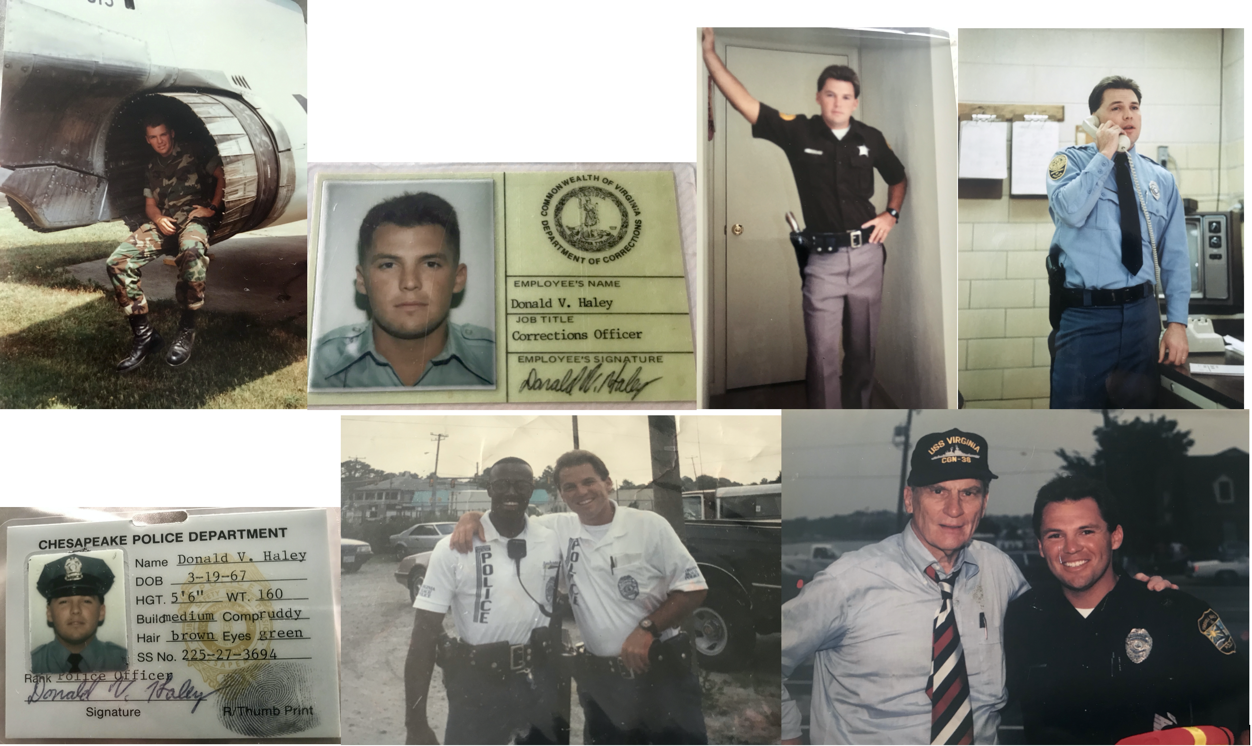


Slide 4
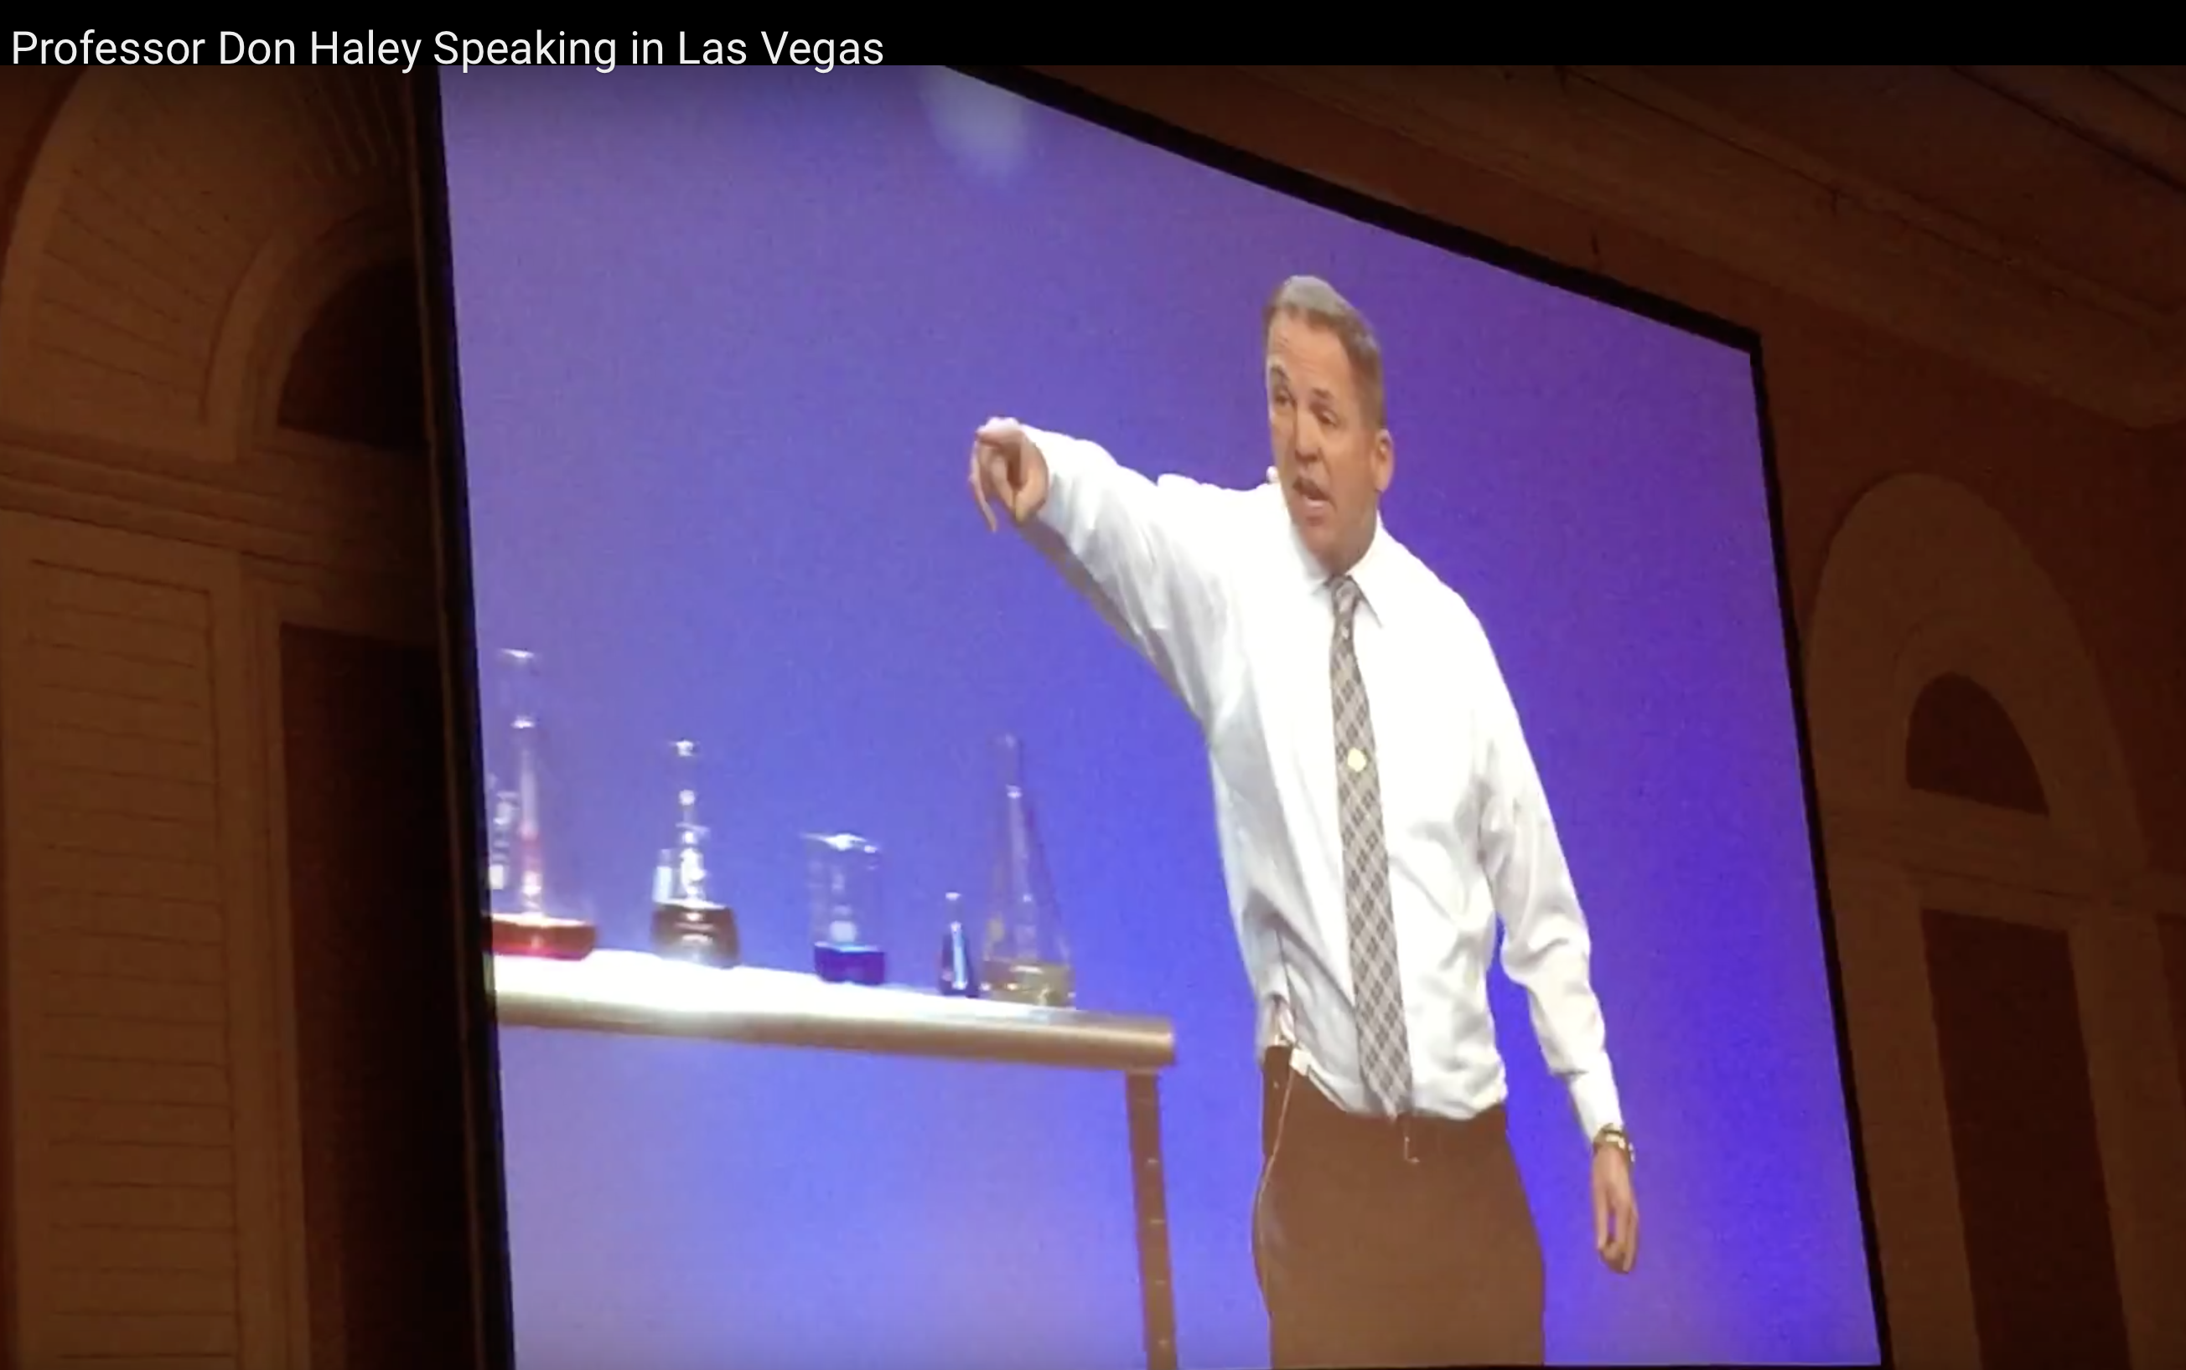
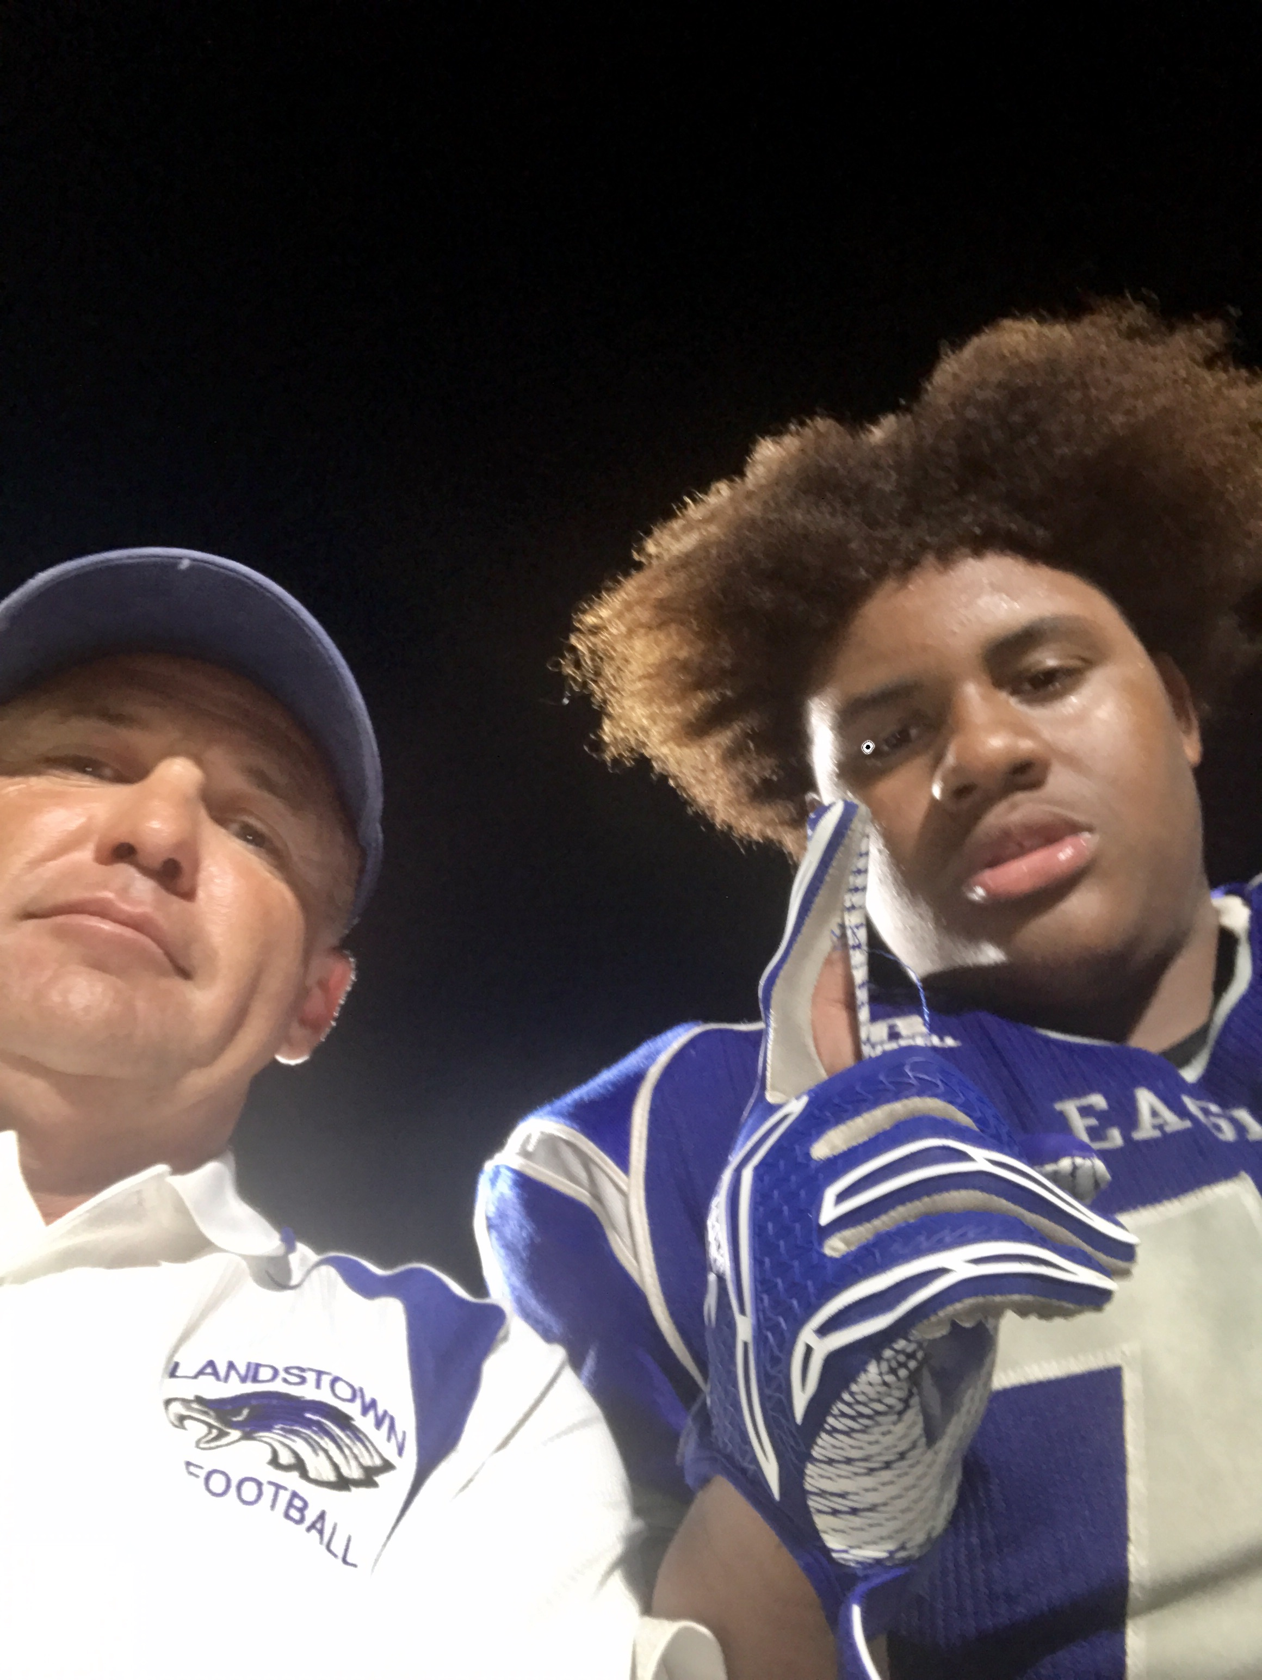
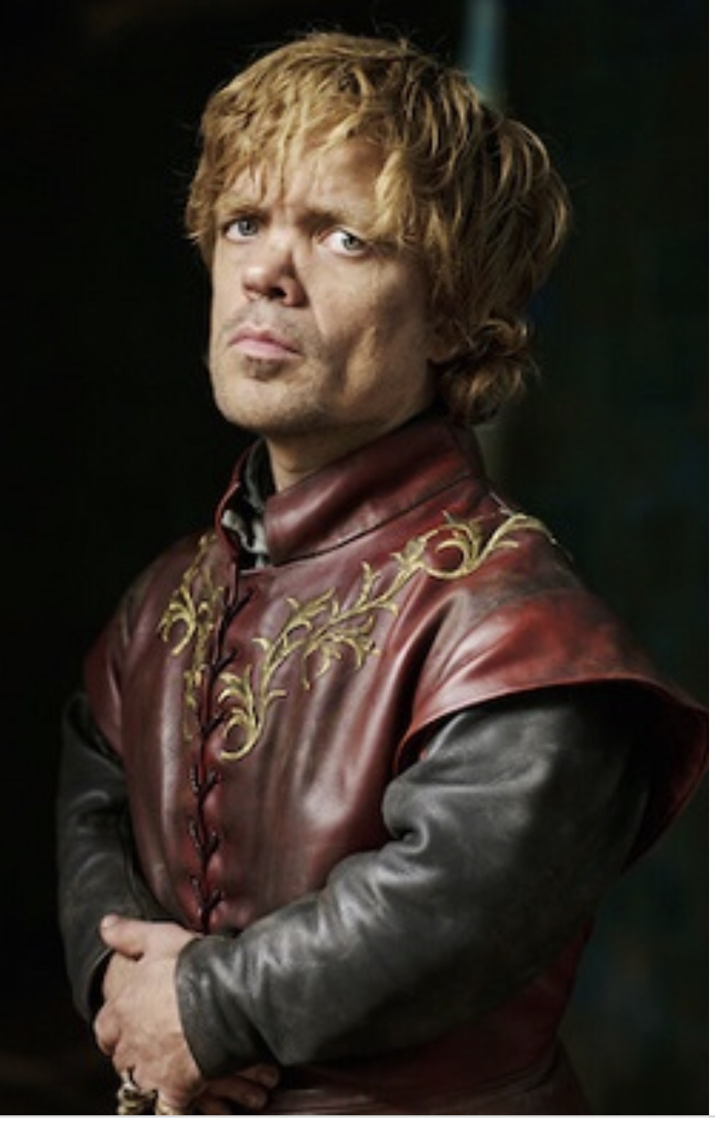
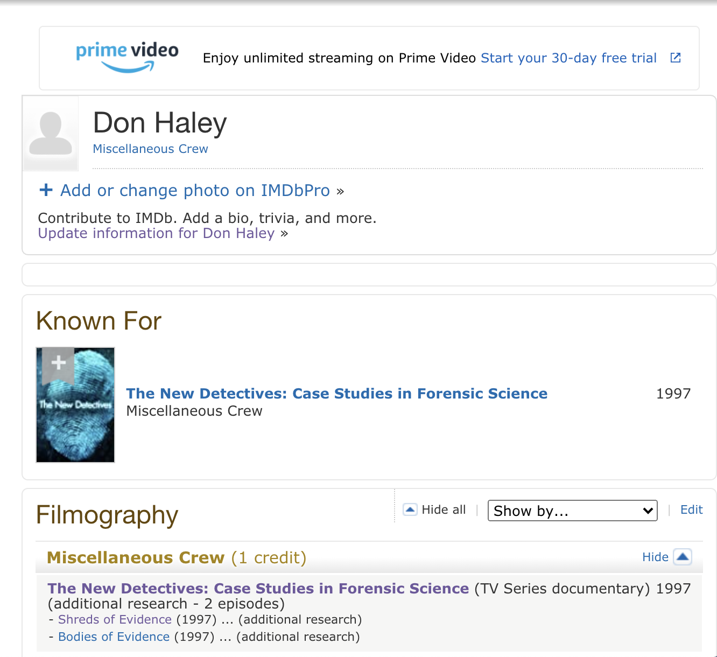

Slide 5
At the completion of this webinar the viewer will be able to do the following:
Identify the skill sets necessary to handle implementing change as a leader
Explore effective concepts in time management and situational leadership
Learn essential leadership daily “disciplines and decisions”, which lead to efficiency
Identify four universal principles of human Interaction, which are essential to effective leadership
5 Levels of Leadership (Macro Perspective)

Slide 6
If you never want to be criticized during your lifetime, all you have to do are the following 3 things:

Slide 7
If you never want to be criticized during your lifetime, all you have to do are the following 3 things:
Say Nothing
Do Nothing
Become Nothing

Slide 8
Leadership is the art of influencing and directing individuals in such a way as to obtain their willing obedience, confidence, respect, and cooperation.

Slide 9


Leadership is not a noun.*
It is a verb
It is action
It is moving *
Text Comments to: 757-675-5922

Slide 10
What changes occur once we assume a position of leadership?
Text Answer to: 757-675-5922

Slide 11
Skills to Handle Change
Studies suggest that as many as 70 percent of change management initiatives fail.
WHY?

Slide 12
ONE ANSWER
It’s often not because the change itself is the problem. It’s how the changes are being articulated.

Slide 13
Whenever change is in the mix, dissension will almost always follow.
“If you want to make enemies, try to change something.”
–Woodrow Wilson

Slide 14

* How we respond to pushback is what matters most.

Slide 15
How Effective Leaders should NOT respond to Pushback over Changes within the Department coming from above:
1) We should NOT try suppressing the dissention, before understanding where it is coming from.
2) We should avoid going into explanation mode in response to the immediate dissention being voiced at that time.
Ronald Reagan once stated, “If you're explaining, you're losing.”
a) The dissension won’t go away unless you’ve addressed the negative emotions and dynamics that are fueling it. *

Slide 16

Once we address the negative thoughts with our direct reports, the barrier comes down and the positive processes take over, allowing us to secure our point or the mandated change in a way that they will begin the buy in process.

Slide 17
When challenging conversations rear their ugly heads, effective leaders are aggressive in their pursuit of understanding *

Slide 18

That understanding enables them to smoothly navigate the conversations, keeping their team engaged along the way.

Slide 19
“Go To”:
The following phrase is an excellent “Go To” to bring someone back from an episode of
“Twisted Reality”:
"I want you to feel like you're being treated fairly at all times. Please stop me at any time if you feel like you're being treated unfairly, and we'll address it."*

Slide 20
1) It utilizes the word, “Fair”. The most powerful word in resolving conflicts and negotiations is the word "FAIR”.
. . . Individuals are more likely to comply with requests and resolve conflict, if they think they have been treated fairly, and lash out if we don't.

Slide 21
2) It is empowering and offers your counterpart a perceived reality of control. By us stating “ . . . and we'll address it.” It comforts our counterpart and makes them believe they will be heard.*

Slide 22

* Time Management and Situational Leadership
Effective leaders know where their time goes and manage it actively.

Slide 23
3 Key Essentials in Time Management for Leaders
1. They identify and eliminate things that need not be done at all.
2. They delegate to other individuals’ things that can be done, as well or better by someone else.
3. They avoid wasting their own time and the time of others.

Slide 24





Either we are going to manage our time, or our time will manage us.*

Slide 25
What are some of the BASIC time killers that we can identify in the average individual’s life, that do not lead to productivity and efficiency?
Text Answers to
757-675-5922

Slide 26
What are some of the BASIC time killers that we can identify in the average individual’s life, that do not lead to productivity and efficiency?
1) Social Media
2) Certain Meetings (Faculty Senate)
3) Junk Mail
4) Junk Email
5) Surfing the net aimlessly
6) Aimless conversations
7) Time Wasters that
8) Time Wasters: Changing one’s own oil.
9) Watching TV
10) Failing to delegate insignificant tasks

Slide 27
We as leaders should gear our efforts towards RESULTS, not WORK.*

Slide 28
If someone with a lower rank than you can perform the same task with a 90% or more acceptability rate, then we should delegate that job.

Slide 29

What are the major reasons for our inefficient use of time at work?
Text to 757-675-5922

Slide 30
The Major reasons for our inefficient use of time at work are as followed:
1) Telephone interruptions
2) Drop-in visitors
3) Meetings (Scheduled or Unscheduled)
4) Crisis
5) Lack of Objectives
6) Cluttered Desk and personal disorganization
7) Ineffective delegation
8) Too much work attempted at once and unrealistic time estimates
9) Lack of or unclear communications/instructions
10) Inadequate, inaccurate, or delayed information
11) Indecision and Procrastination
12) Confused responsibility and authority

Slide 31
13) Inability to say “No”.
14) Lack of self-discipline
15) Not knowing what to do with paper clutter.
There are only four things you can do with paper:
A) Toss it
B) Refer it (Pass it on to someone else . . . delegate)
C) Act on it
D) File
16) Proper triaging of emails

Slide 32
Our Success Agenda is Determined by Our:
1. Daily Decisions we make
2. Daily Disciplines we practice

Slide 33

“You don’t make decisions because they’re easy; you don’t make decisions because they’re cheap; you don’t make decisions because they’re popular; you make decisions because they’re right.”
– Theodore Hesburgh

Slide 34
Guidelines to Consider for Making Right Decisions:
A) Seek out wise counsel
B) Look for patterns in the guidance we are given.
C) Ensure our decisions are legally sound
D) Ensure our decisions are ethically sound.
  “Relativity applies to Physics, not Ethics”
E) Ensure our decisions give us peace?
F) Examine the downside of our decisions? *
  1. Can we live with our decision if things go sideways?
G) Does the decision match our gifts and our abilities?

Slide 35
What is a MAJOR Common denominator found in success?

Slide 36
What is a MAJOR Common denominator found in success?
Forming the habit of doing things that failures do not like to do.

Slide 37

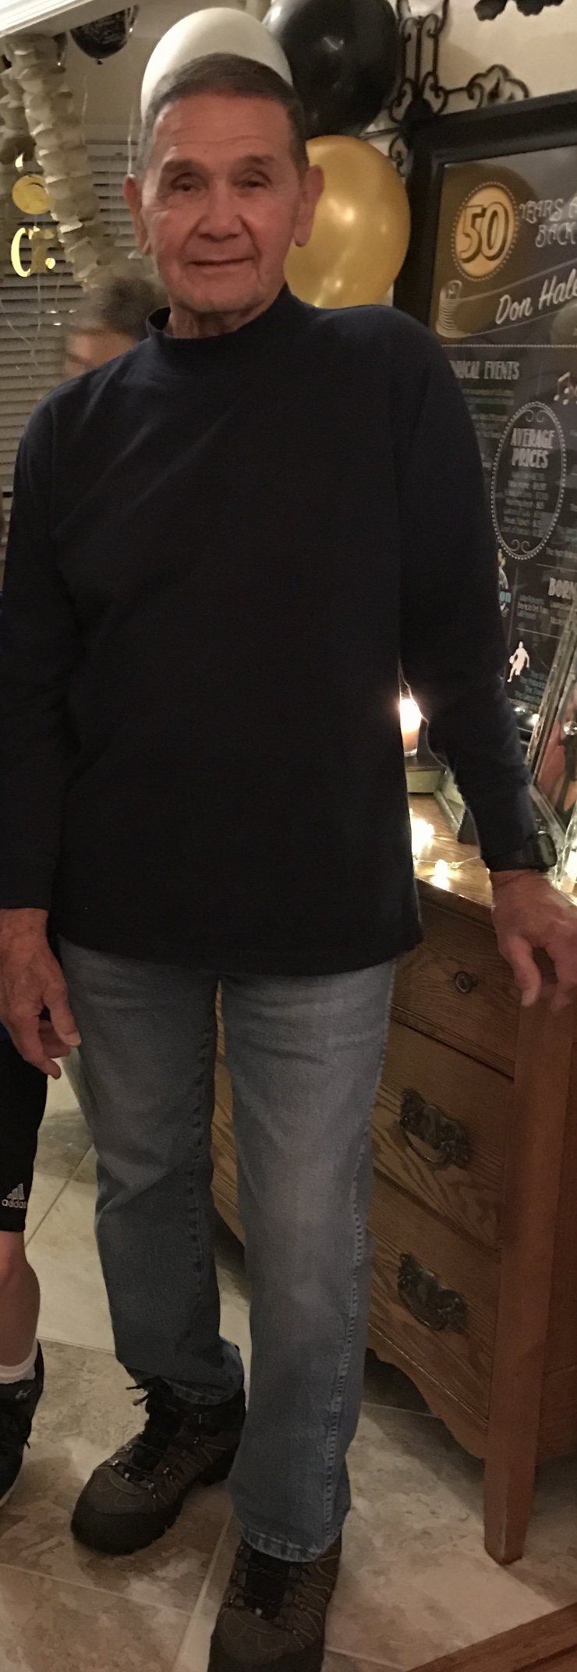
DWOW!
Do
What
Others
Won’t

Slide 38
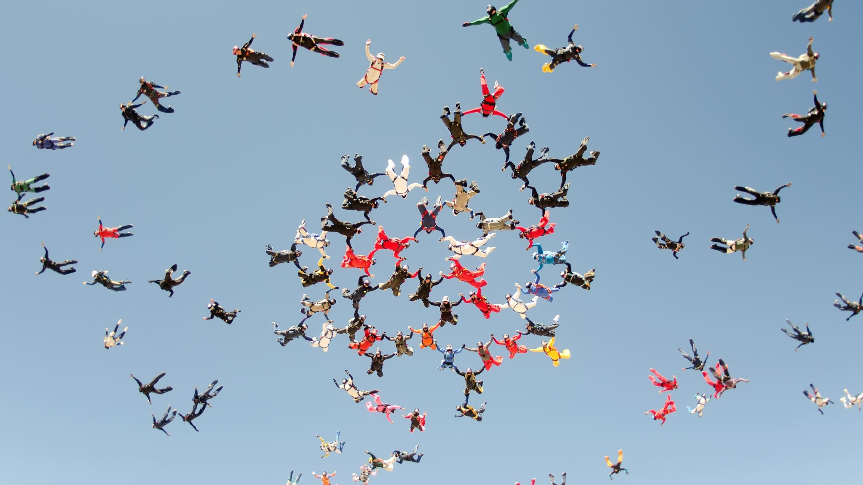
Discipline is the means to getting what you really want even when you don’t want to do the things necessary to get it.*

Slide 39
Two types of pain in life:
i. The pain of self-discipline: eased by the reward of daily progress.
(If you fail to partake in self-discipline, you will partake in regret.)
ii. The pain of regret: increases with missed opportunities and age

Slide 40
Daily decisions = goal setting
Daily disciplines = goal doing.
Decisions and disciplines we make and practice daily:

Slide 41
A Prioritized Daily Task List is essential to increasing your efficiency as a leader.
WHY? Let’s List some Pro’s and Con’s
Text Don Haley 757-675-5922

Slide 42
How to Initiate and Duplicate Task Lists
“Would it be unreasonable for me to respectfully ask you to participate in some one-on-one mentorship in order to get you ready for the next level in your promising career?”

Slide 43
What do you think the following quote is in relation to:
“Most people underestimate today and overestimate tomorrow.”
Text Don Haley 757-675-5922

Slide 44

Answer:
Procrastination

Slide 45
Everyone please text me a one sentence statement that would qualify as, “The Idiot’s Philosophy of Human Interaction.”
Text Don 757-675-5922

Slide 46
The Idiot’s Philosophy of Human Interaction
“I talk to people the way they talk to me!”
The Platinum Rule – “Treat people better than they expect to be treated.”

Slide 47
Four Universal Principles of Human Interaction
  1. Everyone wants to be important.
  2. No one wants to look stupid. (I used to think the same thing, then I found out . . .)
  3. Everyone wants to be appreciated.
  4. Never criticize, condemn, or complain.

Slide 48

What do you think the number one fear that most people have within an organization?
Text 757-675-5922

Slide 49
Answer:
The fear of looking stupid.
(Excerpted from Communication Excellence, Brian J. Polansky Ph.D.)

Slide 50
5 Levels of Leadership
Level 1 — Position
The lowest level of leadership is the Position itself.
It’s the only level that requires no ability or effort to achieve.
At Level 1, people only follow if they believe that they have to.

Slide 51
Individuals who remain on the “Position Level” may find it difficult to work with volunteers.
Why?
Text 757-675-5922

Slide 52
Answer:
Because position does not automatically result in influence, and volunteers are aware that they don’t have to follow anyone. They truly only follow if they want to.

Slide 53
Level 2 — Permission
“Rules without relationships leads to rebellion.”
Josh McDowell
Level 2 is based on relationships.

Slide 54
Connection is the difference.
Individuals choose to follow us because they want to.

Slide 55
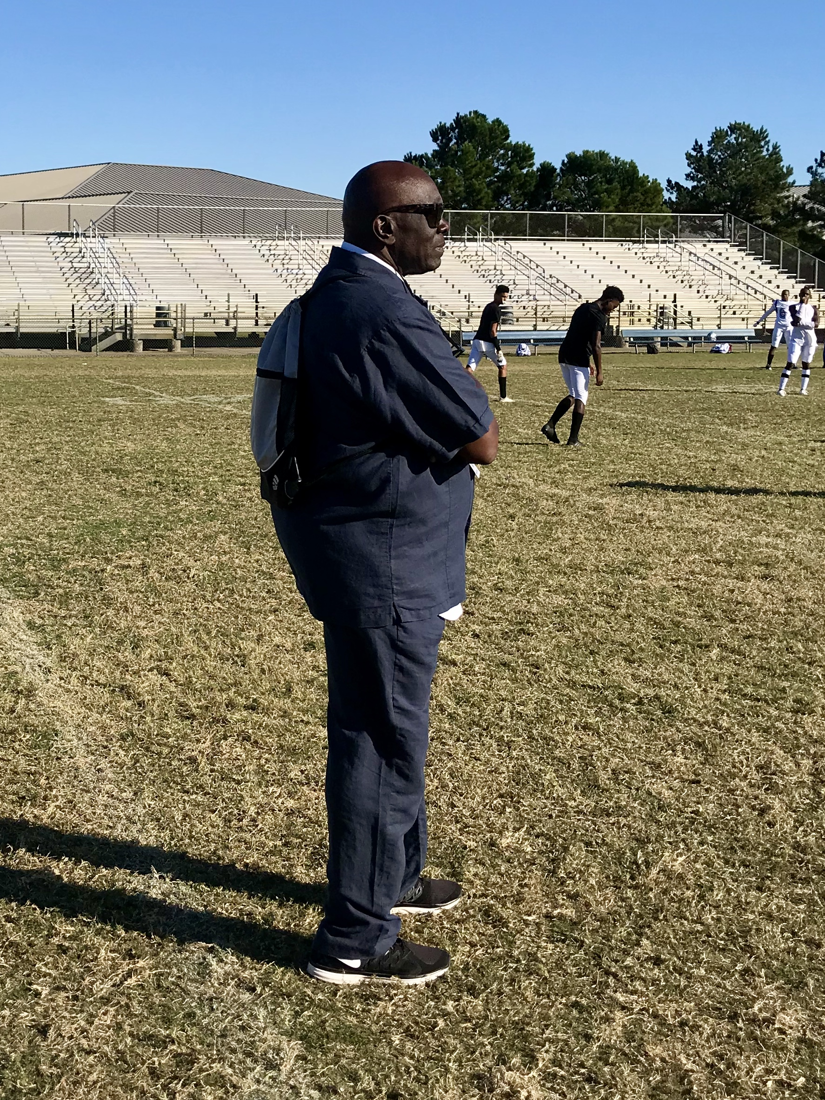
To grow at level 2, leaders work on getting to know their people and connecting with them.

Slide 56
Trust grows, which usually leads to respect.
And the environment becomes much more positive.
Level 2 is where solid, lasting relationships are built that create the foundation for the next level.

Slide 57
Level 2 leaders: Become Proficient at Utilizing Emotional Intelligence Techniques while Connecting.*
A) Listen well
B) Observe
C) Offer feedback
D) Are in a constant state of learning
E) Possess a servanthood attitude *

Slide 58

Level 3 — Production
We Become the Example: (Tour Guide)
The best leaders know how to motivate their people to get things done.
Executing and getting things done is what Level 3 is all about.

Slide 59
On this level, leaders who produce results build their influence and credibility.
People still follow because they want to. However, people follow Level 3 leaders because of their track record.

Slide 60
Work gets done, morale improves, turnover rates go down, and goals are achieved.
Momentum is developed in Level 3 and production levels increase.*

Slide 61
At Level 3
Leading and influencing others becomes fun, because when everyone is moving forward together, the team rises to another level of effectiveness.

Slide 62
What Law of Attraction comes into play during Level 3?
Text 757-675-5922

Slide 63
ANSWER:
The Law of Attraction comes into play. Because who you are as a leader, becomes who you attract on your squad, department, platoon, etc.*

Slide 64
Level 4 - People Development
Level 4 can be summed up in one word: “Reproduction”

Slide 65
Our goal at this level is to identify and develop as many leaders as we can by investing in them and helping them grow.

Slide 66
At Level 4
Discover what people are good at and help them develop it, until they can help someone else, develop that same skill.

Slide 67
Lou Holtz once said, “I am a better football coach with better players.”

Slide 68

Therefore:
Recruit well *
Position well *
Equip well *

Slide 69
Level 5 – Pinnacle - The highest level of leadership and the most challenging to attain
Level 5 is a culmination of leading well on all four previous levels of leadership.
The individuals who reach Level 5, lead so well for so long that they create a legacy of leadership in the organization they serve.
Reaching Level 5 requires longevity as well as intentionality.

Slide 70
Why is it important to know which level of leadership you are on?

Slide 71
Why is it important to know which level of leadership you are on?
ANSWER:
You must know where you are, to know where you’re going.

Slide 72
As the Cheshire Cat told Alice in Wonderland, “When you don’t know where you’re going, any road will get you there.”

Slide 73
It has been a True Honor to serve you all.
Kind Regards,
Don V. Haley

Slide 74
Contact Information
Call or text (757) 675-5922
Email: DonVhaley@gmail.com
www.DonHaley.com

